Slide 1
05 – Copilot Chat In the IDE
Github Copilot Chat features of Visual Studio and Visual Studio Code

Slide 2
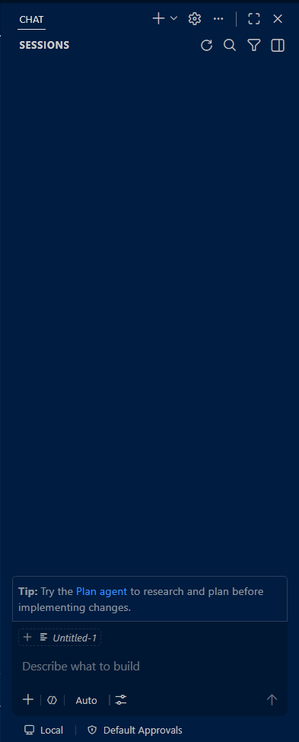
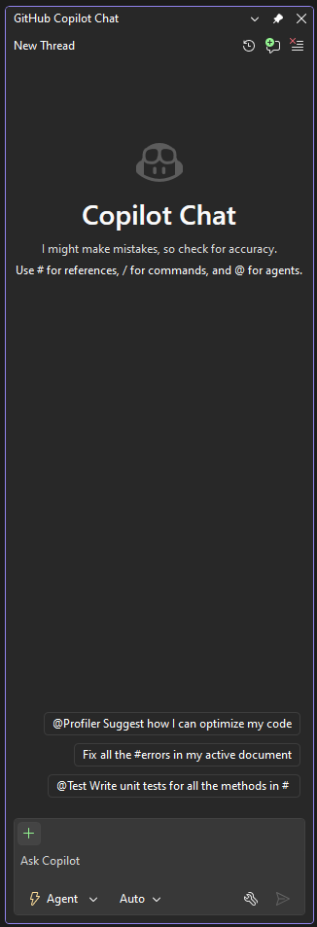
Same same but different
The UX for Copilot Chat in VS2026 and VS Code differs somewhat.
We’ll learn and practice both variations.

Slide 3
Setting up
Fork both these Github repos into your personal GH accounts:
ASP.Net: https://github.com/naya-tech-college/aspnetcore-realworld-example-app
Angular: https://github.com/naya-tech-college/angular-realworld-example-app
Then clone both repos into your computers.

Slide 4
HOW COPILOT INDEXES YOUR CODE
When you start
What the index enables
Copilot automatically builds a semantic index of your workspace or solution
Indexing runs in the background and stays up to date as your code changes
It covers relevant text files and skips binaries, excluded, and ignored files
Semantic search: finds code by meaning using vector embeddings, not just keywords
Copilot retrieves the most relevant files and adds them to your prompt
Scales from a handful of files to very large codebases

Slide 5
THREE KINDS OF INDEX
Remote
Local
Basic
For repos on GitHub or Azure DevOps; GitHub builds and updates it
Fast even on huge codebases and often ready instantly
Built from the repository's default branch
An advanced semantic index stored on your own machine
Used when there is no remote index; fast and accurate, up to ~2,500 files
Simpler local search for larger codebases when a local index is not available
Always works, but less accurate than semantic search

Slide 6
WHAT'S IN THE INDEX — AND WHAT ISN'T
In the index
Not in the index
Committed code — the remote index reflects your default branch
Relevant text files across the whole project
Kept current in the background as you commit
Unsaved edits and brand-new files, until you save or push
Feature branches are not separately indexed
Binary files, and anything you exclude or gitignore

Slide 7
WHY YOU STILL NEED #
The index finds; you focus
Reference it with #
Indexing feeds automatic retrieval — a best guess at what matters
The model only reasons over context actually attached to your prompt
# pins exact files, symbols, or selections so Copilot does not guess
Visual Studio: #BasketService.cs, #MyMethod, #changes, #commit:
VS Code: #file, #codebase, #selection, #terminalSelection
Best for ambiguous prompts, new or unsaved files, or narrowing scope

Slide 8
CONTEXT REFERENCES ( # )
What # does
Why it helps
Type # in the chat box to attach specific context to your prompt
Reference files, symbols, and more by name — no copy-paste
A picker of available items appears as you type #
Scopes Copilot to the exact code you mean
Produces sharper, more relevant answers
Same idea in Visual Studio and VS Code

Slide 9
# REFERENCES IN VISUAL STUDIO
Reference | What it adds to your prompt
#<file> | Contents of a specific file (e.g. #Program.cs)
#<symbol> | A method, class, or function by name
#changes | Your uncommitted Git changes
#commit: | A specific commit from your history
#output | Logs from the Output window (Build, Debug, Tests)
#prompt: | A reusable prompt file from .github/prompts

Slide 10
# MENTIONS IN VS CODE
#-mention | What it adds to your prompt
#<file> | Attach a specific file by name
#<folder> | Attach every file in a folder
#<symbol> | A class or function from an open file
#codebase | Search the whole indexed workspace
#fetch | Pull content from a web page or URL
#terminalSelection | The selected terminal output

Slide 11
SLASH COMMANDS
Shortcuts that set your intent fast — type / in Copilot Chat.
Skip long prompts for routine tasks: explain, fix, generate tests.
Work in the Chat pane; edit commands also work in inline chat.
Available commands vary by IDE, context, and installed extensions.
The core set is nearly identical in Visual Studio 2026 and VS Code.
Source: GitHub Copilot Chat cheat sheet — docs.github.com/en/copilot/reference/chat-cheat-sheet
Notes:
https://learn.microsoft.com/en-us/visualstudio/ide/copilot-chat-context?view=visualstudio
https://code.visualstudio.com/docs/agent-customization/prompt-files

Slide 12
VISUAL STUDIO 2026 — COMMANDS
Built-in slash commands (type / in Copilot Chat):
/doc — add a documentation comment
/explain — explain the selected code
/fix — propose a fix for problems in the selection
/optimize — improve performance of the selected code
/tests — generate unit tests for the selection
/help — quick help on using Copilot
Also available in inline chat (Alt + /).
Source: Visual Studio docs — learn.microsoft.com/visualstudio/ide/copilot-chat-context

Slide 13
VS CODE — COMMANDS
Built-in slash commands (type / in Copilot Chat):
/explain — explain the selected code
/fix — propose a fix for problems in the selection
/tests — generate unit tests for the selection
/fixTestFailure — find and fix a failing test
/new — scaffold a new project or file
/clear — start a new chat session
Prompt files and agent skills also appear here as / commands.
Source: VS Code docs — code.visualstudio.com/docs/copilot/customization/prompt-files

Slide 14
PROMPT FILES REUSABLE PROMPTS
GitHub Copilot · In-IDE · Day 2
Notes:
Source: https://docs.github.com/en/copilot/tutorials/customization-library/prompt-files/your-first-prompt-file

Slide 15
WHAT IS A PROMPT FILE?
A prompt file is a reusable prompt that you write once and use many times as a custom slash (/) command.

Slide 16
ANATOMY OF A PROMPT FILE
The file: explain-code.prompt.md
---
agent: 'agent'
description: 'Generate a clear code explanation with examples'
---
Explain the following code in a clear, beginner-friendly way:
Code to explain: ${input:code:Paste your code here}
Target audience: ${input:audience:Who is this explanation for? (e.g., beginners, intermediate developers, etc.)}
Please provide:
* A brief overview of what the code does
* A step-by-step breakdown of the main parts
* Explanation of any key concepts or terminology
* A simple example showing how it works
* Common use cases or when you might use this approach
Use clear, simple language and avoid unnecessary jargon.
Front Matter (YAML)
Body (Markdown)

Slide 17
ANATOMY OF A PROMPT FILE
The file: explain-code.prompt.md
---
agent: 'agent'
description: 'Generate a clear code explanation with examples'
---
Explain the following code in a clear, beginner-friendly way:
Code to explain: ${input:code:Paste your code here}
Target audience: ${input:audience:Who is this explanation for? (e.g., beginners, intermediate developers, etc.)}
Please provide:
* A brief overview of what the code does
* A step-by-step breakdown of the main parts
* Explanation of any key concepts or terminology
* A simple example showing how it works
* Common use cases or when you might use this approach
Use clear, simple language and avoid unnecessary jargon.
Choice of Agent
Human Input Tags

Slide 18
CREATE OR OPEN A PROMPT FILE
Visual Studio Code
Visual Studio 2026
Chat view → Configure Chat (gear) → Prompts → New Prompt
Or Command Palette: “Chat: New Prompt File”
Stored in .github/prompts as *.prompt.md
[ screenshot: Agent Customizations → Prompts ]
In the solution root, add a .github\prompts folder
Add a file named DescriptiveName.prompt.md
In Chat, click ➕ → Prompts, or type / to invoke
[ screenshot: Copilot Chat prompt list ]

Slide 19
EXERCISE — YOUR FIRST PROMPT FILE
Copy the code into a new file.
Save as explain-code.prompt.md
Place it in .github/prompts at the repo root

Slide 20
EXERCISE — TRY IT ON OUR REPO
.NET · Visual Studio 2026
Angular · VS Code
Repo: aspnetcore-realworld-example-app
Open a controller, e.g. ArticlesController
Run /explain-code and paste the class
Audience: a new team member
Repo: angular-realworld-example-app
Open a service, e.g. articles.service.ts
Run /explain-code and paste the service
Audience: a junior Angular dev

Slide 21
EXERCISE — RUN /explain-code
Visual Studio Code
Visual Studio 2026
Open the Copilot Chat view
Type /explain-code and press Enter
Copilot switches to agent mode and asks for the inputs
Open Copilot Chat (Ctrl+\, C)
Type / and pick explain-code (bookmark icon)
Enter the code and audience when prompted

Slide 22
FURTHER READING
VS Code: code.visualstudio.com/docs/copilot/customization/prompt-files ·
Visual Studio: learn.microsoft.com/visualstudio/ide/copilot-chat-context

Slide 23
Copilot Chat Sessions
A session in Copilot is one conversation between you and it
You can run several sessions in parallel, each on a different task, and switch between them.

Slide 24
Session settings
A session is configured by three selections:
Session type — where it runs (Local / CLI / Cloud)
Agent — the role Copilot adopts (Ask, Plan, Agent, custom…)
Model — which AI model powers the conversation

Slide 25
Session Types: Where Does It Run?
Local
CLI (background)
Cloud
Runs inside your IDE on the open workspace files.
Edits stream into the editor; you approve tools interactively.
Best for hands-on, iterative work.
Runs Copilot CLI as a background process, usually in an isolated Git worktree.
Your working files stay untouched while it runs.
Monitor from the sessions list.
Runs on GitHub's infrastructure against a repository.
Works autonomously, even with your machine off.
Delivers results as issues and pull requests.

Slide 26
What Is an "Agent"?
An agent is a persona and configuration for Copilot behavior.
An agent is made of:
Instructions — a prompt describing the role, rules, and workflow
Tools — the capabilities it may use (read, edit, terminal, MCP…)
Model (optional) — a preferred model; otherwise the picker selection
Extras — handoffs to other agents, subagents, hooks (VS Code)

Slide 27
The Ask Agent
Use Ask to research new codebases and when you want full manual control over every change.
Question & answer mode: ask coding questions in natural language, grounded in your development context.
Never edits code on its own — changes apply only via Copy, Insert in new file, or Apply/Preview (shown as a diff).
Great for explaining code, syntax and concept questions, exploring options, and generating snippets to review first.

Slide 28
The Plan Agent
Use Plan for big features, or refactorings and unfamiliar codebases.
Creates and refines an implementation plan before any code changes.
Explores the codebase with read-only tools and asks clarifying questions.
The plan is saved as Markdown (.copilot/plans/) — refine it in chat or edit the file.
When satisfied, select "Implement plan" to hand off to the Agent.

Slide 29
The Agent (Agent Mode)
Give a high-level task; the agent plans the steps, edits files, runs terminal commands, and invokes tools.
Monitors outcomes — builds, failing tests, tool output — and iterates until done or it needs input.
Tools include built-in tools, MCP servers, and skills. You approve terminal commands and non-built-in tools.
Stay in control: review diffs per file, Keep/Undo changes, or Restore to a checkpoint.
Use Agent after you’ve implemented the techniques we’ll learn in the course.

Slide 30
Specialized Agents
Debug & optimize
Test & modernize
Ship & collaborate
@debugger — diagnoses errors using call stacks, variables, and diagnostics
@profiler — connects to VS profiling tools to find bottlenecks
@test — generates unit tests matching your framework and conventions
@modernize — (.NET & C++) upgrades frameworks and dependencies
@git — generate commit messages and review local changes
@cloud — start remote coding-agent sessions; create issues and PRs
Visual Studio only. Invoke via the agent picker or by typing @ + agent name.

Slide 31
Hands-On: Build a Unit-Testing Agent
Goal: cover a given method with high-quality unit tests.
5 steps, one per slide — the same .agent.md format works in both IDEs.
Visual Studio 2026 track
VS Code track
Repo: aspnetcore-realworld-example-app
Stack: C#, xUnit, Moq
Repo: angular-realworld-example-app
Stack: Angular, Vitest, TestBed, ng-mocks

Slide 32
Step 1 — Create the Agent File
Custom agents are Markdown files named *.agent.md under .github/agents/.
Visual Studio 2026
In Solution Explorer, create .github/agents/unit-tester.agent.md
User-level agents live in %USERPROFILE%\.github\agents
VS Code
Run “Chat: New Custom Agent” or type /agents → New Agent (Workspace).
Name it unit-tester; VS Code creates the .agent.md file for you.

Slide 33
Step 2 — Define the Frontmatter
The YAML header declares name, description, and allowed tools:
---
name: Unit Tester
description: Cover a function or method with unit tests
tools: ['search', 'edit', 'runCommands'] # VS Code
---
Tool names differ per IDE — click the Tools icon in chat to see the exact names. Keep the list minimal.

Slide 34
Step 3 — Write the Instructions
Below the frontmatter, write the testing rules in Markdown:
Specific, checkable rules beat vague ones — a numbered checklist the agent must complete.
1. Read the method and its dependencies first.
2. Use xUnit + Moq (VS) / Vitest + TestBed + ng-mocks (VS Code).
3. Arrange-Act-Assert; one behavior per test.
4. Cover happy path, edge cases, and errors.
5. Mock external dependencies; run the suite and fix failures.

Slide 35
Step 4 — Use Your Agent
Save the file, then select Unit Tester in the agent picker (or type @unit-tester in Visual Studio).
Visual Studio: “Cover the Create handler in Features/Articles with unit tests.”
VS Code: “Cover the ArticlesService with unit tests.”
Watch it search the code, generate tests, run them, and iterate on failures.
Review the diffs before you Keep the changes — you own the result, not the agent.

Slide 36
Step 5 — Refine and Share
Inspect the tests: naming, mocks, edge cases. Tighten the instructions where output fell short, and rerun.
Commit .github/agents/unit-tester.agent.md — everyone who clones the repo gets the agent.
The same format powers CLI and Cloud sessions, so the agent can run in the background or on GitHub.
Bonus (VS Code): add a handoff to a code-review agent after tests are written.
Discussion: what other team workflows deserve their own agent?

Slide 37
MODEL SELECTION AT A GLANCE
Auto by default
Pick per task
Both IDEs start in Auto — Copilot picks an available model to cut latency and rate limits
Hover a reply to see which model actually ran
Switch to a specific model at any time
Stronger reasoning model for complex work; a fast one for quick edits
Chat model and inline-completion model are chosen separately
Business / Enterprise: your admin controls which models appear

Slide 38
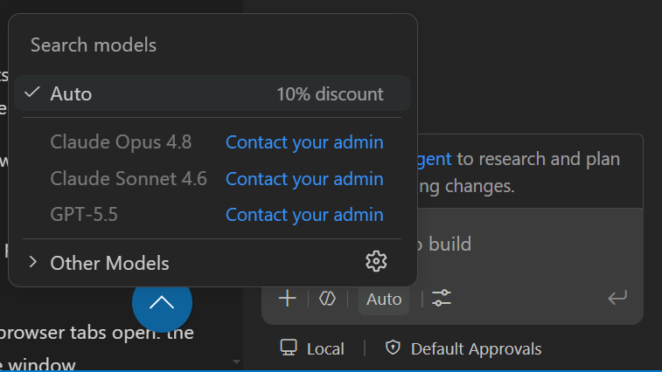
PICK A MODEL — VS CODE
Steps
Open Copilot Chat and click the model picker in the chat input
Choose Auto, or pick a specific model from the list
Pin favorites with the pin icon; completions use a separate model

Slide 39
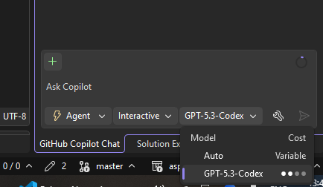
PICK A MODEL — VISUAL STUDIO
Steps
Open the Copilot Chat window and open the Model picker dropdown
Pick Auto or a model; your choice persists across threads
Cost indicators show each model's multiplier; unlisted models can be enabled

Slide 40
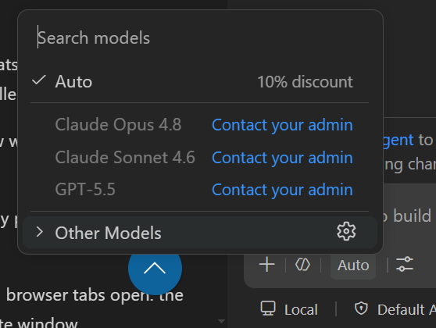
CUSTOM MODEL — VS CODE (BYOK)
Bring your own key
Model picker → Manage Models → choose a provider (OpenAI, Anthropic, Google, Azure…)
Enter your API key; select which models to add to the picker
Works without a Copilot plan; run local models via the Ollama extension

Slide 41
CUSTOM MODEL — VISUAL STUDIO
Add your own model?
Not available in Visual Studio.
Must be set up via github.com admin section.

